Slide 1
Directions for your slide
Step 1 The words at the top cannot be covered up with photos
Step 2 As part of your vision board, think of what you would like to be, do and have in your life as an adult.
Step 3 On your computer, open a document or presentation in Google Docs or Slides.
Step 4 Click Insert. Image.
Step 5 Choose your image from Google search Click Insert or Open.

Slide 2
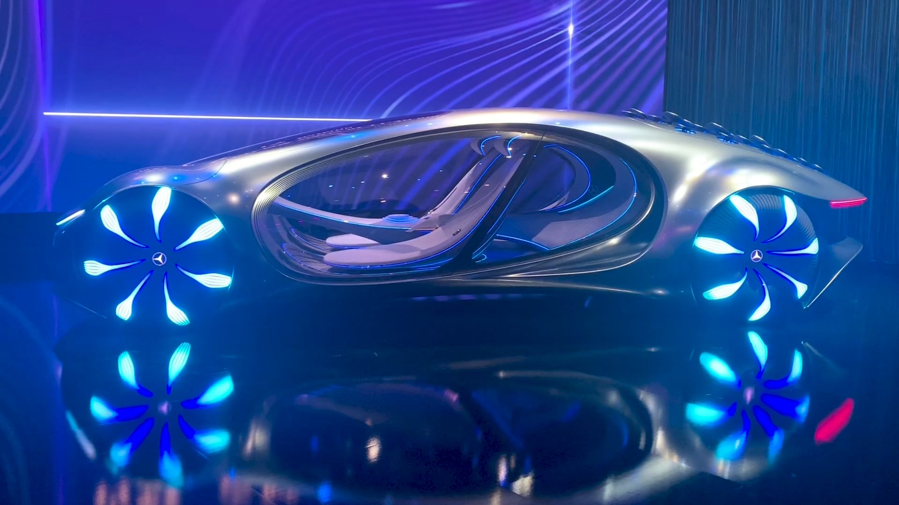
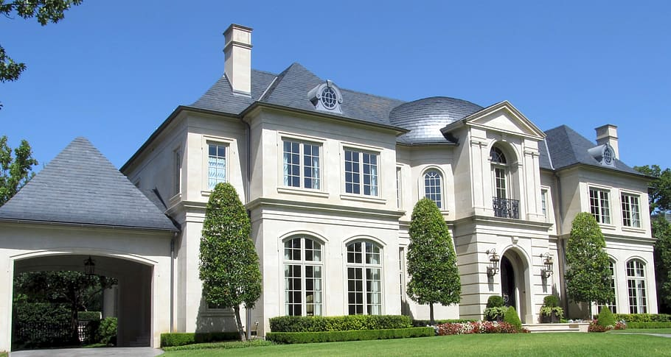
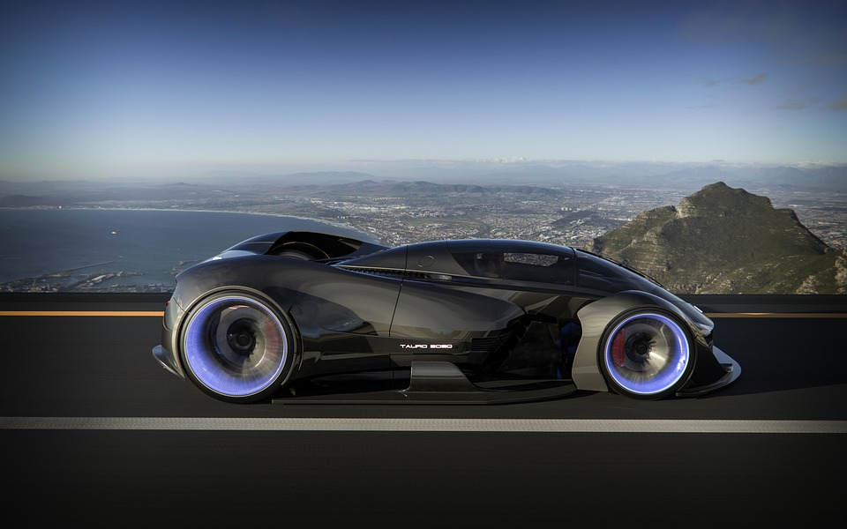
“A successful life is about getting what you want and avoiding needless trouble. You come to school so you can learn what you need to know for your future success and happiness!”
Example
Notes:
This is one EXAMPLE of how your page can look.

Slide 3
“A successful life is about getting what you want and avoiding needless trouble. You come to school so you can learn what you need to know for your future success and happiness!”
Notes:
Create your own page here.

